Slide 1
Multi-view Information Bottleneck Representation Learning
①
②
③
Multi-view IB in a supervised fashion
Dual-view IB in a supervised fashion and data augmentation
Robust multi-view IB in a unsupervised fashion
④
⑤
Collaborative multi-view IB in a unsupervised fashion
Multi-view IB without variational approximation
CPS Computational Learning Laboratory
1
Notes:
考虑可变处理时间的FJSP
基于分层RL的FJSP动态调度
FJSP的动态多目标调度
基于分层RL的自适应多目标多任务调度方法
动态部分无等待多目标FJSP的实时调度

Slide 2
②
Dual-view IB in a supervised fashion and data augmentation
Variational approximation
①
③
Multi-view IB in a supervised fashion
Robust multi-view IB in a unsupervised fashion
Supervised learning
Unsupervised learning
Matrix-based Rényi’s α-order entropy function
⑤
④
Multi-view IB without variational approximation
Collaborative multi-view IB in a unsupervised fashion

Slide 3

Paper 1
Deep Multi-view Information Bottleneck
Qi Wang, Claire Boudreau, Qixing Luo, Pang-Ning Tan, and Jiayu Zhou
Published in: Proceedings of the 2019 SIAM International Conference on Data Mining (SDM)
Published Time: 2019
CPS Computational Learning Laboratory
3
Notes:
这篇论文结合了可变处理时间（VPT），重点研究了在动态和不确定条件下优化完工时间解决FJSP

Slide 4
01
Problem Description
02
Method Design
03
Experiment Results
Contents
04
Conclusion
CPS Computational Learning Laboratory
4
Notes:
主要分为以下四个部分

Slide 5
01
Problem Description
02
Method Design
03
Experiment Results
Contents
04
Conclusion
CPS Computational Learning Laboratory
5
Notes:
首先是问题描述

Slide 6
Problem Description
Multi-view IB for accurate representation learning in a supervised fashion
This study proposes a supervised multi-view learning framework based on the information bottleneck principle to filter out irrelevant and noisy information from multiple views and learn an accurate joint representation.
Challenge
1.The relationships between different views are often complicated and nonlinear.
2.Computing mutual information requires estimation of the posterior distribution, which is computationally intractable when the model is complicated.
Method
The method maximizes the mutual information between the labels and the learned joint representation while minimizing the mutual information between the learned latent representation of each view and the original data representation.
The method employs the variational inference method to efficiently solve the optimization problem.
CPS Computational Learning Laboratory
6
Notes:
探讨了一种新的动态柔性车间调度问题（DFJSP）模型，该模型结合了可变处理时间（VPT），重点研究了在动态和不确定条件下优化完工时间。开发了一种通过基于历史调度数据预提取可行动作来减少搜索空间和计算复杂度的方法。

Slide 7
01
Problem Description
02
Method Design
03
Experiment Results
Contents
04
Conclusion
CPS Computational Learning Laboratory
7

Slide 8
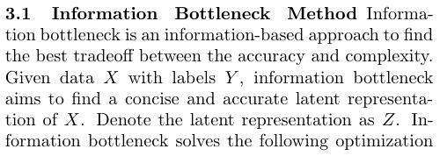
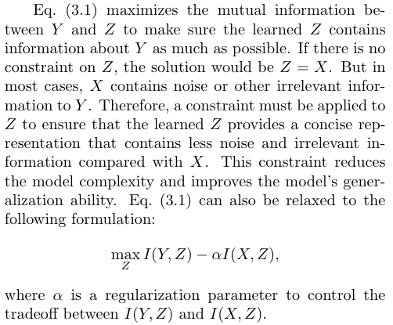
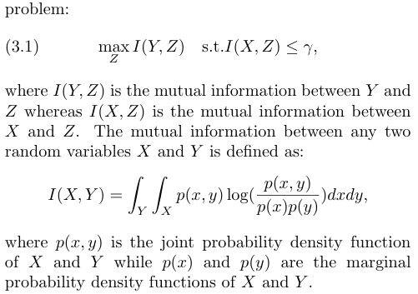
Method Design
CPS Computational Learning Laboratory
8

Slide 9
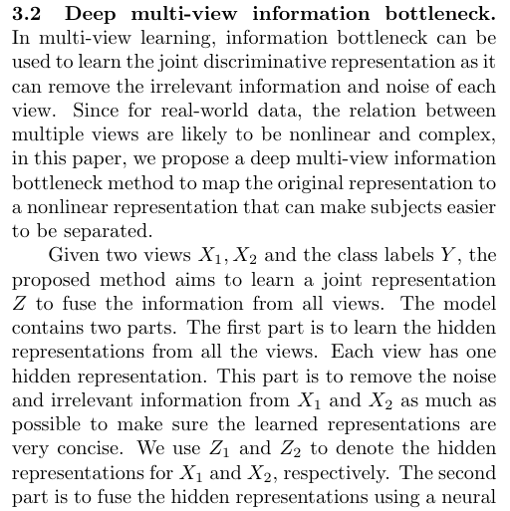
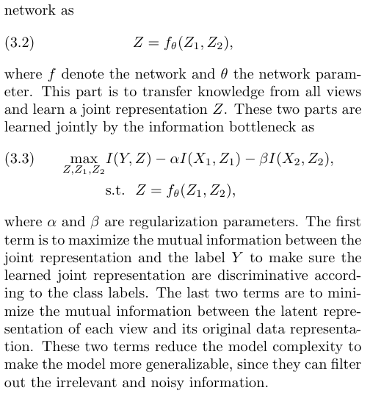
Method Design
CPS Computational Learning Laboratory
9

Slide 10
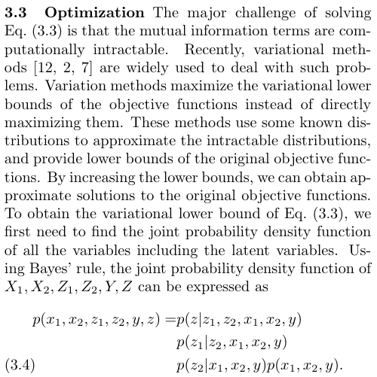
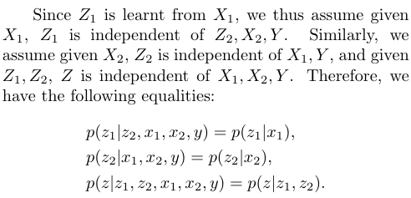
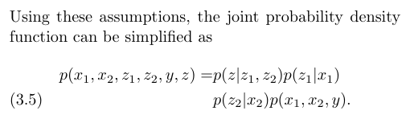
Method Design
CPS Computational Learning Laboratory
10

Slide 11
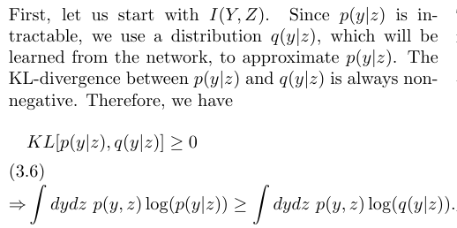
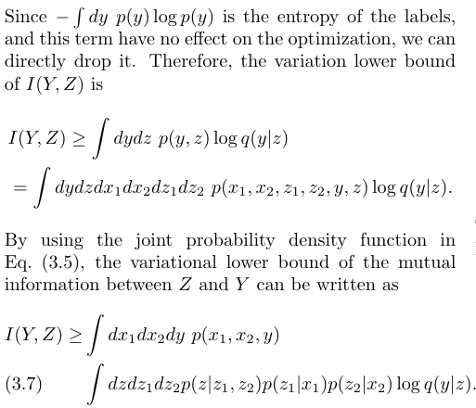
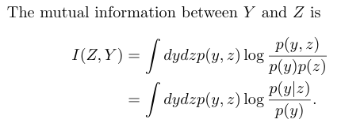
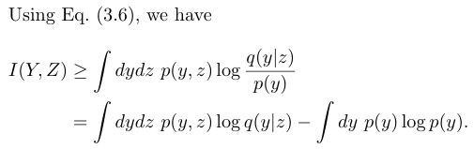
Method Design
CPS Computational Learning Laboratory
11

Slide 12
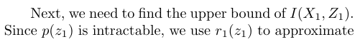
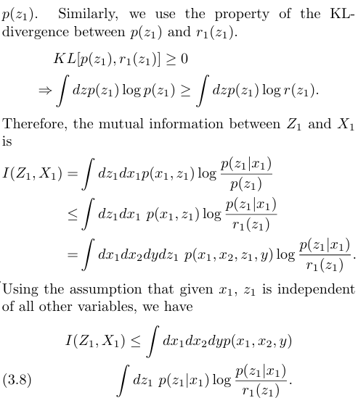
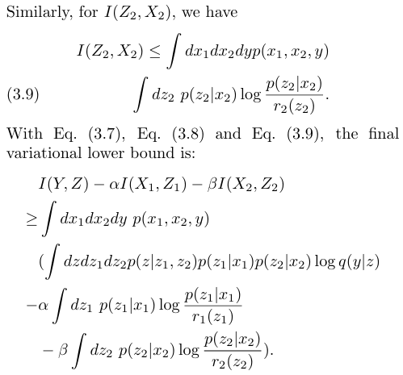
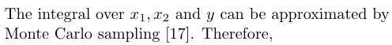



Method Design
CPS Computational Learning Laboratory
12

Slide 13
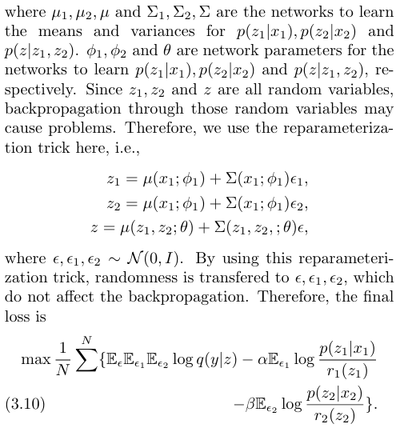
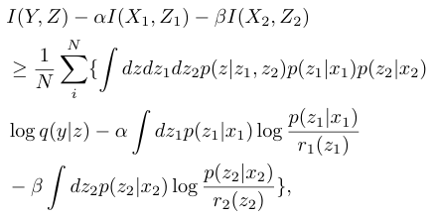
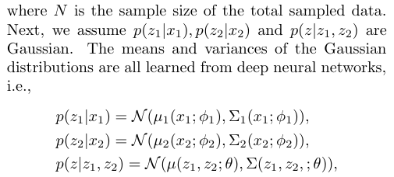
Method Design
CPS Computational Learning Laboratory
13

Slide 14
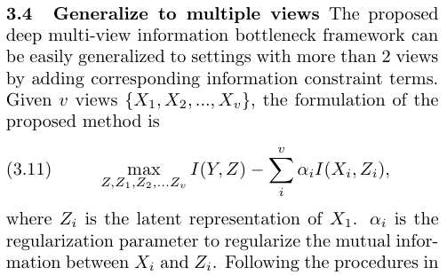
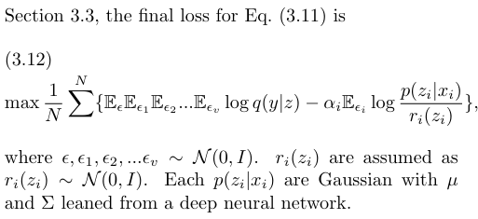
Method Design
CPS Computational Learning Laboratory
14

Slide 15
01
Problem Description
02
Method Design
03
Experiment Results
Contents
04
Conclusion
CPS Computational Learning Laboratory
15

Slide 16
Experiment Results
Dataset
1. Synthetic dataset
2. Real-world dataset
Baseline methods
Linear canonical correlation analysis (CCA)
Deep canonical correlation analysis (DCCA)
Deep canonically correlated auto-encoders (DCCAE)
Fully-connected deep neural network (DNN) (contains two fully-connected neural networks to directly extract latent representations, and then a deep neural network to fuse latent representations to make prediction).
CPS Computational Learning Laboratory
16

Slide 17
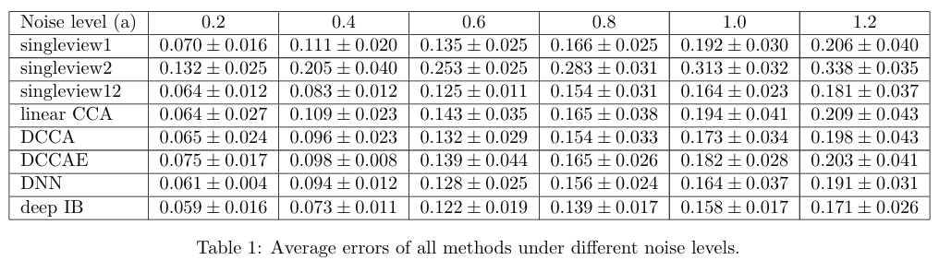
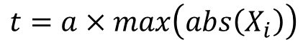
Experiment Results
Setting 1
We change the noise level t and compare our model with other baselines.
$$t=a×max\left(abs\left(X_{i}\right)\right)$$
The sample size per class is set to be 500. The useful feature dimension is 20, and the extra-feature dimension is 5. c
CPS Computational Learning Laboratory
17

Slide 18
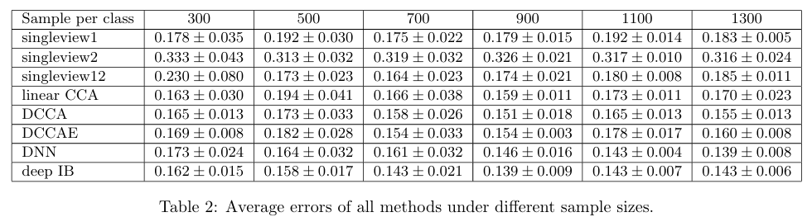
Experiment Results
Setting 2
We vary the sample size per class to see how the performance changes.
The noise level a is set to be 1.0. The useful feature dimension is 20, and the extra-feature dimension is 5.
CPS Computational Learning Laboratory
18

Slide 19
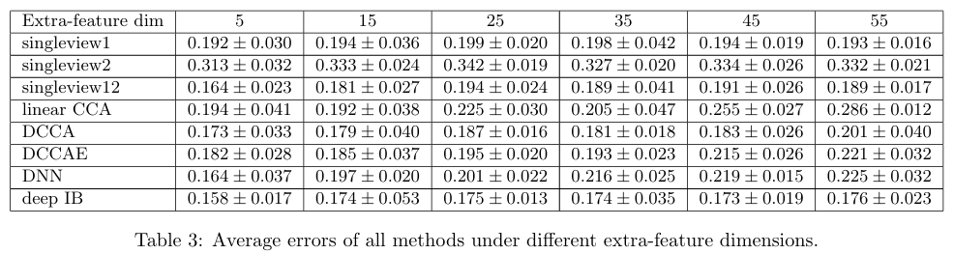
Experiment Results
Setting 3
We change the extra-feature dimension to see how the extra-feature dimension affects the results.
The sample size per class is set to be 500. The noise level a is set to be 1.0.
CPS Computational Learning Laboratory
19

Slide 20
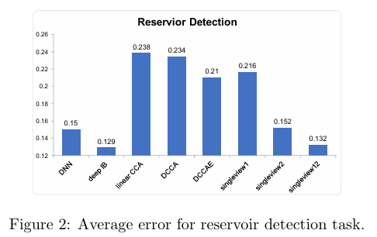
Experiment Results
A case study: reservoir detection
We compare all the models on a reservoir detection dataset. There are two views available in this dataset. The first one is the boundary of the lakes. The second view is the features extracted from Google Earth.
CPS Computational Learning Laboratory
20

Slide 21
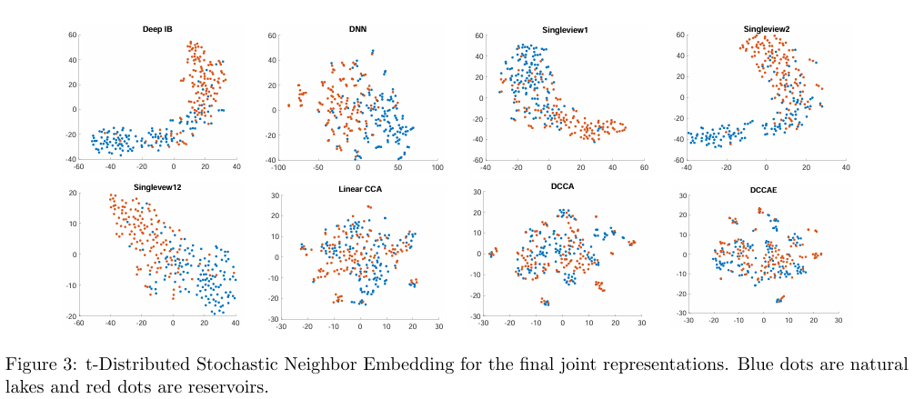
Experiment Results
A case study: reservoir detection
CPS Computational Learning Laboratory
21

Slide 22
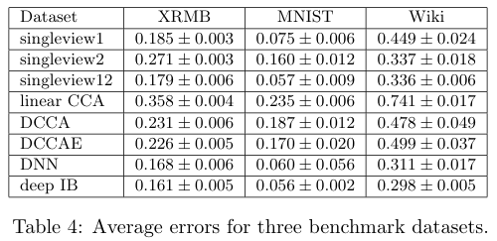
Experiment Results
A case study: reservoir detection
CPS Computational Learning Laboratory
22

Slide 23
01
Problem Description
02
Method Design
03
Experiment Results
Contents
04
Conclusion
CPS Computational Learning Laboratory
23
CPS Computational Learning Laboratory
2
18

Slide 24
Conclusion
①
The paper introduces a novel deep multi-view information bottleneck method that integrates knowledge from multiple views to enhance predictive performance.
②
The proposed method leverages variational inference to address computational challenges, making it feasible to optimize using standard gradient descent methods.
CPS Computational Learning Laboratory
24
Notes:
本文介绍了一种考虑处理时间可变性（VPT）的DFJSP模型，并提出了一种使用PPO的两阶段动态调度框架。实验结果表明，与遗传算法、蚁群算法和单一调度规则相比，PPO具有更优的性能和泛化能力，最大优化率为94.29%。

Slide 25
Paper 2
Dynamic scheduling for flexible job shop using a deep reinforcement learning approach
Jing Wang, Yuanjie Zheng, Jingqi Song, and Sujuan Hou
Publish Journal: ACM International Conference on Multimedia (ACM MM)
Published Time: 17 October 2021
CPS Computational Learning Laboratory
25
Notes:
基于深度强化学习的柔性作业车间动态调度

Slide 26
01
Problem Description
02
Method Design
03
Experiment Results
Contents
04
Conclusion
CPS Computational Learning Laboratory
26
Notes:
主要分为以下四个部分

Slide 27
01
Problem Description
02
Method Design
03
Experiment Results
Contents
04
Conclusion
CPS Computational Learning Laboratory
27
Notes:
首先是问题描述

Slide 28
Problem Description
Dynamic scheduling for FJSP
This study investigates the information bottleneck to the multi-view learning for extracting the different view common features of one category, named Dual-View Information Bottleneck representation (Dual-view IB).
Challenge
Most existing multi-view algorithms usually maximize the correlation between different views for consistency, ignore the interaction among different views and may cause semantic bias during the process of common feature learning.
Method
We maximize the mutual information between the representations of the two views to achieve the preservation of key features in the classification task, while eliminating the redundant information that is not shared between the two views.
We further introduce a novel Pair Batch Data Augmentation (PB) algorithm for Dual-view IB model.
CPS Computational Learning Laboratory
28

Slide 29
01
Problem Description
02
Method Design
03
Experiment Results
Contents
04
Conclusion
CPS Computational Learning Laboratory
29
Notes:
研究现状

Slide 30
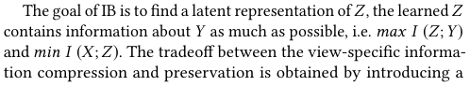
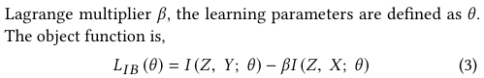
Method Design
IB concepts
CPS Computational Learning Laboratory
30

Slide 31
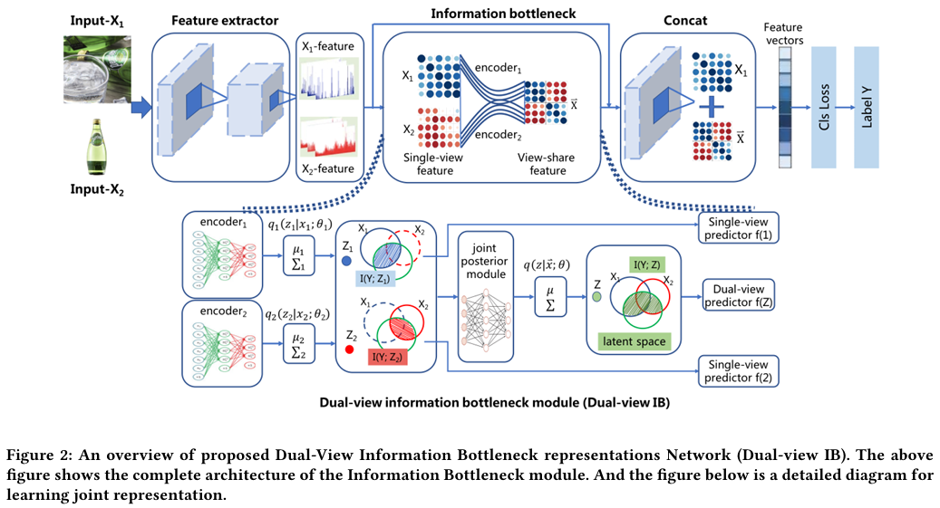
Method Design
Dual-View Information Bottleneck representation
CPS Computational Learning Laboratory
31

Slide 32
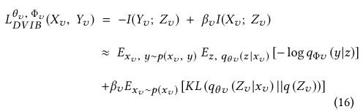
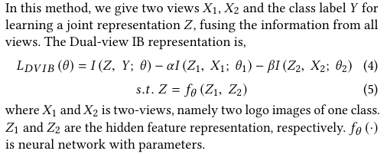
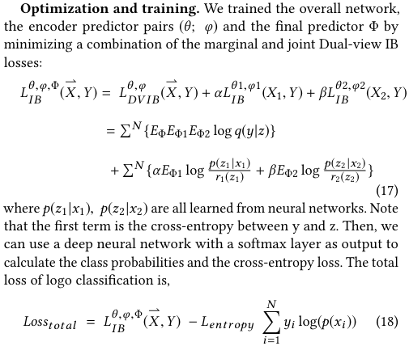
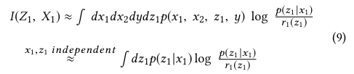
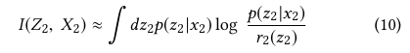
Method Design
CPS Computational Learning Laboratory
32

Slide 33
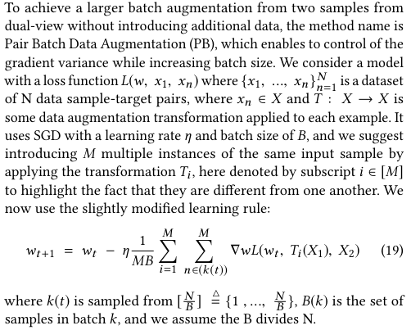
Method Design
Pair Batch Data Augmentation Strategy
CPS Computational Learning Laboratory
33

Slide 34
01
Problem Description
02
Method Design
03
Experiment Results
Contents
04
Conclusion
CPS Computational Learning Laboratory
34

Slide 35
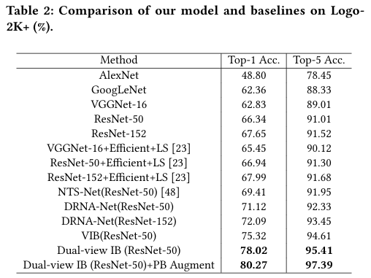
Experiment Results
Experiments on Logo-2k+
Baseline methods
1. AlexNet
2. GoogLeNet
3. VGGNet
4. ResNet
5. Single-View IB (VIB)
CPS Computational Learning Laboratory
35

Slide 36
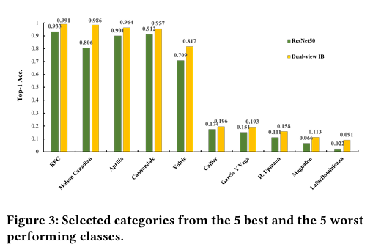
Experiment Results
Experiments on Logo-2k+
CPS Computational Learning Laboratory
36

Slide 37
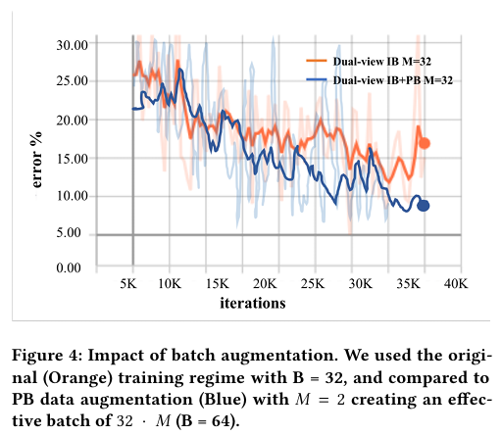
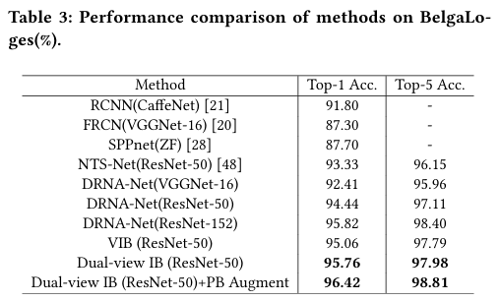
Experiment Results
Experiments on BelgaLoges Baseline
CPS Computational Learning Laboratory
37

Slide 38
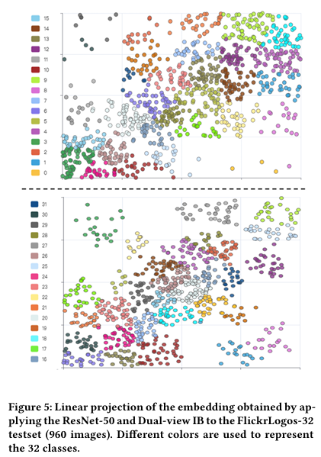
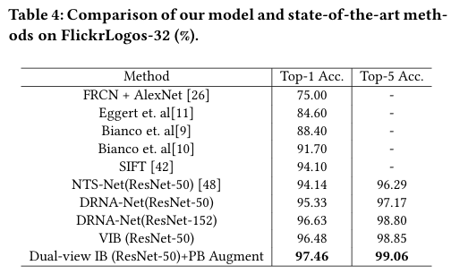
Experiment Results
Experiments on FlickrLogos-32 Baseline
CPS Computational Learning Laboratory
38

Slide 39
01
Problem Description
02
Method Design
03
Experiment Results
Contents
04
Conclusion
CPS Computational Learning Laboratory
39
CPS Computational Learning Laboratory
2
18

Slide 40
Future Work
Contributions
The Pair Batch Data Augmentation (PB) method is proposed to address the issue of unbalanced categories in the Dual-view Information Batching model. This method aims to enhance robust feature representation and improve computational resource utilization by employing larger augmented batches and transformers.
Future Work
The future work involves exploring cross-modal representation learning of text and visual information in logo classification, as well as applying multi-view IB representation learning to other tasks such as person re-identification and image segmentation.
CPS Computational Learning Laboratory
40

Slide 41
Paper 3
Learning Robust Representations via Multi-View Information Bottleneck
Marco Federici, Anjan Dutta, Patrick Forre, Nate Kushmann, and Zeynep Akata
Published in: Computing Research Repository (CoRR)
Published Time: 27 Feb 2020
CPS Computational Learning Laboratory
41

Slide 42
01
Problem Description
02
Method Design
03
Experiment Results
Contents
04
Conclusion
CPS Computational Learning Laboratory
42
Notes:
主要分为以下四个部分

Slide 43
01
Problem Description
02
Method Design
03
Experiment Results
Contents
04
Conclusion
CPS Computational Learning Laboratory
43
Notes:
首先是问题描述

Slide 44
Problem Description
Robust multi-view IB method for unsupervised representation learning
This paper extends the information bottleneck method to the unsupervised multi-view setting. Hence one can improve generalization by discarding all the information not shared by both views from the representation.
Challenge
The original IB formulation, however, requires labeled data to identify the superfluous information.
Method
Maximizing the mutual information between the representations of the two views while at the same time eliminating the information not shared between them.
We also extend our theory to the single-view setting by taking advantage of standard data augmentation techniques.
CPS Computational Learning Laboratory
44

Slide 45
01
Problem Description
02
Method Design
03
Experiment Results
Contents
04
Conclusion
CPS Computational Learning Laboratory
45
Notes:
研究现状

Slide 46
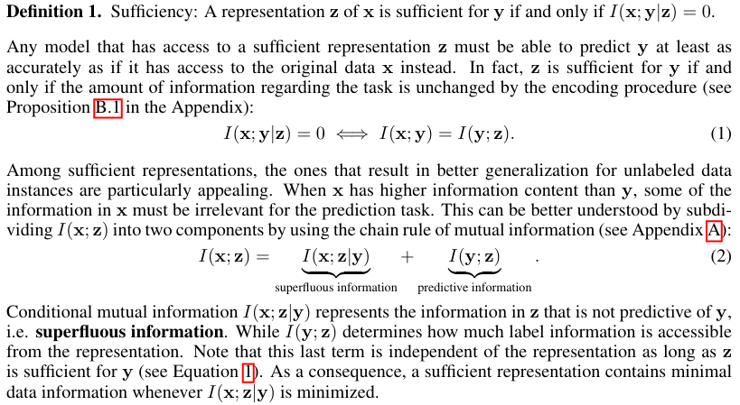
Method Design
CPS Computational Learning Laboratory
46

Slide 47
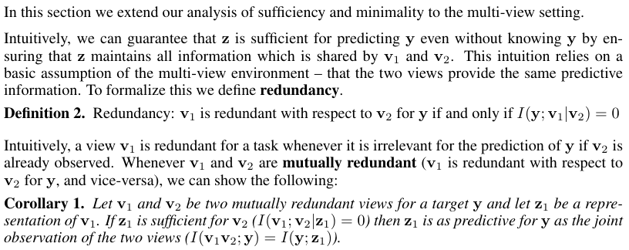
Method Design
Multi-View Information Bottleneck
SUFFICIENCY AND ROBUSTNESS IN THE MULTI-VIEW SETTING
CPS Computational Learning Laboratory
47

Slide 48
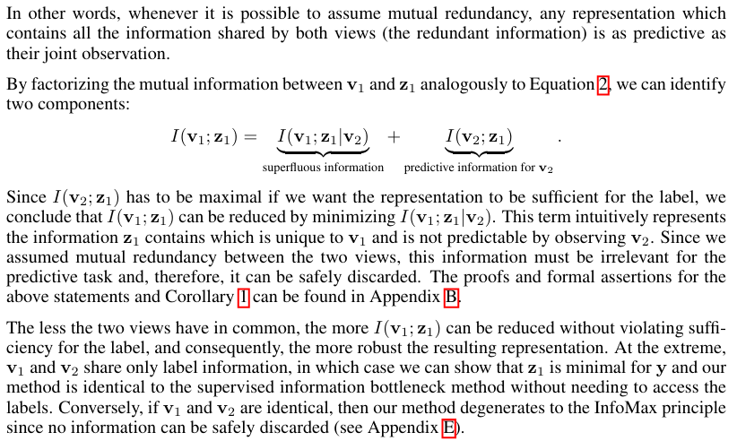
Method Design
CPS Computational Learning Laboratory
48

Slide 49
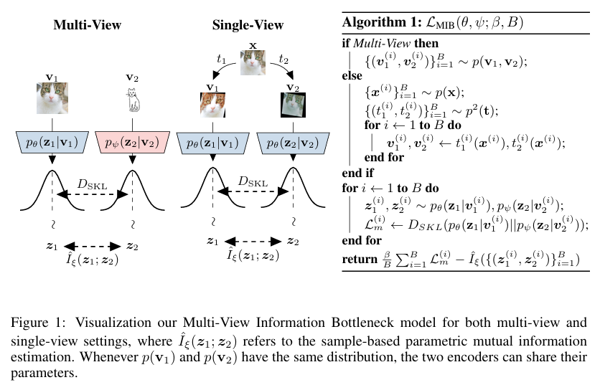
Method Design
CPS Computational Learning Laboratory
49

Slide 50
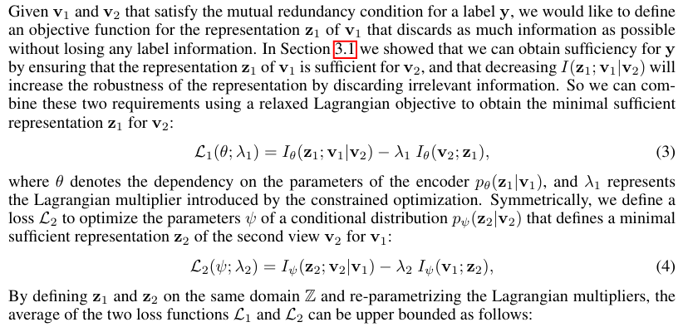
Method Design
THE MULTI-VIEW INFORMATION BOTTLENECK LOSS FUNCTION
CPS Computational Learning Laboratory
50

Slide 51
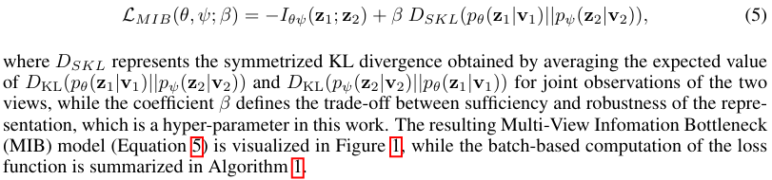
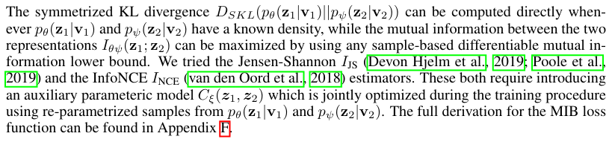
Method Design
CPS Computational Learning Laboratory
51

Slide 52


Method Design
SELF-SUPERVISIONANDINVARIANCE
CPS Computational Learning Laboratory
52

Slide 53
01
Problem Description
02
Method Design
03
Experiment Results
Contents
04
Conclusion
CPS Computational Learning Laboratory
53

Slide 54

Experiment Results
MULTI-VIEW TASKS
sketch-based image retrieval dataset
CPS Computational Learning Laboratory
54

Slide 55

Experiment Results
MIR-Flickr dataset
CPS Computational Learning Laboratory
55

Slide 56


Experiment Results
SELF-SUPERVISED SINGLE-VIEW TASK
CPS Computational Learning Laboratory
56

Slide 57

Experiment Results
ABLATION STUDIES
H.1 DIFFERENT RANGES OF DATA AUGMENTATION
CPS Computational Learning Laboratory
57

Slide 58

Experiment Results
H.2 EFFECT OF β
CPS Computational Learning Laboratory
58

Slide 59
01
Problem Description
02
Method Design
03
Experiment Results
Contents
04
Conclusion
CPS Computational Learning Laboratory
59
CPS Computational Learning Laboratory
2
18

Slide 60
Future Work
Contributions
The authors extend the information bottleneck principle to the unsupervised multi-view setting and provide a rigorous theoretical analysis of its application.
The authors define a new model that empirically leads to state-of-the-art results in the low-label setting on two standard multi-view datasets, Sketchy and MIR-Flickr.
.By exploiting data augmentation techniques, the author empirically show that the representations learned by the model in single-view settings are more robust than existing unsupervised representation learning methods, connecting our theory to the choice of augmentation strategy.
Future Work
Extension to More Than Two Views: The authors aim to explore extending the mutual redundancy condition to more than two views.
Role of Data Augmentation: The authors plan to investigate how different data augmentation techniques can align with the IB principle and enhance invariant neural networks, leveraging known symmetries and data structures.
CPS Computational Learning Laboratory
60

Slide 61
Paper 4
Multi-View Information-Bottleneck Representation Learning
Zhibin Wan, Changqing Zhang, Pengfei Zhu, and Qinghua Hu
Published in: Proceedings of the AAAI Conference on Artificial Intelligence
Published Time: 18 May 2021
CPS Computational Learning Laboratory
61
Notes:
一种基于分层深度强化学习的自适应多目标多任务调度方法

Slide 62
01
Problem Description
02
Method Design
03
Experiment Results
Contents
04
Conclusion
CPS Computational Learning Laboratory
62
Notes:
主要分为以下四个部分

Slide 63
01
Problem Description
02
Method Design
03
Experiment Results
Contents
04
Conclusion
CPS Computational Learning Laboratory
63
Notes:
首先是问题描述

Slide 64
Problem Description
Collaborative multi-view IB for flexible unsupervised representation learning
This paper proposes a novel and flexible unsupervised multi-view representation learning model termed Collaborative Multi-View Information Bottleneck Networks (CMIB-Nets), which comprehensively explores the common latent structure and the view-specific intrinsic information, and discards the superfluous information in the data.
Challenge
It is a long term challenge to jointly exploit the view-specific information of each view and the complex relationships among different views under the context of multi-view representation learning.
Mutual information is computationally intractable.
Method
Maximizing the mutual information between multi-view information-bottleneck representation and shared representation (learning the common structure), while at the same time maximizing the mutual information between multi-view information-bottleneck representation and view-specific representations (learning the view-specific information). We also minimize the mutual information between original views and multi-view information-bottleneck representation simultaneously (compressing data to remove useless information).
CPS Computational Learning Laboratory
64

Slide 65
01
Problem Description
02
Method Design
03
Experiment Results
Contents
04
Conclusion
CPS Computational Learning Laboratory
65
Notes:
研究现状

Slide 66

Method Design
CPS Computational Learning Laboratory
66

Slide 67


Method Design
Consistency: Shared Representation
CPS Computational Learning Laboratory
67

Slide 68

Method Design
Complementarity: View-specific Representation
CPS Computational Learning Laboratory
68

Slide 69





Method Design
Multi-view Information-Bottleneck Representation
The objective is induced as
CPS Computational Learning Laboratory
69

Slide 70


Method Design
CPS Computational Learning Laboratory
70

Slide 71



Method Design
CPS Computational Learning Laboratory
71

Slide 72
01
Problem Description
02
Method Design
03
Experiment Results
Contents
04
Conclusion
CPS Computational Learning Laboratory
72

Slide 73
Experiment Results
Dataset
Metrics
1. Handwritten
2. ORL
3. COIL-20
4. Caltech101-7
5. BBCSport
6. Caltech-UCSD Birds (CUB)
1. Accuracy (ACC),
2. Normalized Mutual Information (NMI),
3. F-score,
4. Rand Index (RI)
Baseline methods
FeatConcate: This method directly concatenates the features of multiple views.
CCA(Canonical Correlation Analysis
DCCA (Deep Canonical Correlation Analysis
DCCAE (Deep Canonically Correlated AutoEncoders)
DMF-MVC (Deep Semi-NMF for MVC): This method takes advantage of the semi-nonnegative matrix factorization to obtain a representation included consistent information of multiple views.
AE2-Nets (Autoencoder in Autoencoder Networks): This method integrates information from multiple views into a representation bynested autoencoder.
MIB(Multi-view Information Bottleneck):
CPS Computational Learning Laboratory
73

Slide 74

Experiment Results
CPS Computational Learning Laboratory
74

Slide 75

Experiment Results
Robustness Assessment
We verify the robustness of the algorithms by adding the noise to the datasets. A generated noise matrix is produced by randomly sampling from the range [0,1]. Then, we multiply the noise matrix with a scalar 0 < µ < 1 to adjust the noise level.
CPS Computational Learning Laboratory
75

Slide 76

Experiment Results
Ablation Study
Comparison of performances
We conduct a series of clustering experiments by using the original features, shared representation H, view-specific representation S, and multi-view information bottleneck representation Z, respectively.
CPS Computational Learning Laboratory
76

Slide 77

Experiment Results
Comparison of visualizations
CPS Computational Learning Laboratory
77

Slide 78

Experiment Results
Comparison of robustness
we perform clustering ablation experiments on the noisy datasets, and the results are shown in Fig.3.
CPS Computational Learning Laboratory
78

Slide 79


Experiment Results
Model Analysis
CPS Computational Learning Laboratory
79

Slide 80
01
Problem Description
02
Method Design
03
Experiment Results
Contents
04
Conclusion
CPS Computational Learning Laboratory
80
CPS Computational Learning Laboratory
2
18

Slide 81
Future Work
Contributions
The authors propose an unsupervised multi-view representation learning method- Collaborative Multi-View IB, which extends information bottleneck to unsupervised multi-view setting and flexibly learns a representation from heterogeneous data.
The proposed model integrates various representations, leveraging the information bottleneck to collaboratively learn intra-view intrinsic information and inter-view shared structure, while minimizing the influence of superfluous information.
By introducing neural networks and variational inference, the method can explore general correlations among multiple views and approximate mutual information through variational bounds.
Future Work
Future research will focus on extending the current method to an end-to-end model.
CPS Computational Learning Laboratory
81

Slide 82
Paper 5
Multi-View Information Bottleneck Without Variational Approximation
Qi Zhang , Shujian Yu , Jingmin Xin, and Badong Chen
Published in: ICASSP 2022 – 2022 IEEE International Conference on Acoustics, Speech and Signal Processing (ICASSP)
Published Time: 27 April 2022
CPS Computational Learning Laboratory
82
Notes:
基于深度强化学习的动态局部无等待多目标柔性车间实时调度

Slide 83
01
Problem Description
02
Method Design
03
Experiment Results
Contents
04
Conclusion
CPS Computational Learning Laboratory
83
Notes:
主要分为以下四个部分

Slide 84
01
Problem Description
02
Method Design
03
Experiment Results
Contents
04
Conclusion
CPS Computational Learning Laboratory
84
Notes:
首先是问题描述

Slide 85

Problem Description
Multi-View Information Bottleneck Without Variational Approximation
This paper extends the information bottleneck principle to supervised multi-view learning scenario and use the recently proposed matrix-based Renyi’s $α$-order entropy functional to optimize the resulting objective directly, without the necessity of variational approximation or adversarial training.
Challenge
The mutual information estimation in high-dimensional space is widely acknowledged as intractable or infeasible. Existing deep multi-view IB approaches usually use the variational approximation or adversarial training to maximize a lower bound of the original IB objective. However, the tightness of those derived lower bounds is hard to guarantee in practice, especially if there are only limited training data.
Method
Multi-view matrix-based Entropy Information Bottleneck (METB)
CPS Computational Learning Laboratory
85

Slide 86
01
Problem Description
02
Method Design
03
Experiment Results
Contents
04
Conclusion
CPS Computational Learning Laboratory
86
Notes:
研究现状

Slide 87




Method Design
CPS Computational Learning Laboratory
87
Notes:
图1给出了所提出的HMAPPO在不同时空水平上的总体操作机制。objective agent充当周期性地调整较高目标的较高控制器。作业智能体和机器智能体是底层执行者，在每个重调度点分别选择可行的作业选择规则和机器分配规则，以达到更高的目标。

Slide 88




Method Design
CPS Computational Learning Laboratory
88

Slide 89















Method Design
Gram matrix
$$a=\left[a_{1}, a_{2},…,a_{n}\right]$$
$$b=\left[b_{1}, b_{2},…,b_{n}\right]$$
$a和b的$内积公式为：
$a∙b=a_{1}b_{1}+a_{2}b_{2}$+…+ $a_{n}b_{n}$
Gram矩阵是两两向量的内积，所以Gram矩阵可以反映出该组向量中各个向量之间的某种关系。
Rényi熵：信息论中的一种广义熵，用于衡量随机变量的不确定性。与Shannon熵相比， Rényi熵通过引入一个参数（通常称为熵的阶或$α$）来提供熵的不同度量
CPS Computational Learning Laboratory
89

Slide 90
01
Problem Description
02
Method Design
03
Experiment Results
Contents
04
Conclusion
CPS Computational Learning Laboratory
90

Slide 91














Experiment Results
CPS Computational Learning Laboratory
91

Slide 92



Experiment Results
Robustness to Noise
CPS Computational Learning Laboratory
92

Slide 93



Experiment Results
Robustness to Redundant Dimensions
CPS Computational Learning Laboratory
93

Slide 94


Experiment Results
CPS Computational Learning Laboratory
94

Slide 95

Experiment Results
Open problems
CPS Computational Learning Laboratory
95

Slide 96


Experiment Results
Open problems
CPS Computational Learning Laboratory
96

Slide 97
01
Problem Description
02
Method Design
03
Experiment Results
Contents
04
Conclusion
CPS Computational Learning Laboratory
97
CPS Computational Learning Laboratory
2
18

Slide 98
Future Work
Contributions
Developed the Multi-view matrix-Entropy based Information Bottleneck (MEIB) for multi-view learning. Using the recently proposed matrix-based Rényi’s-order entropy functional, MEIB can be optimized directly by SGD or ADAM, without variational approximation or adversarial training.
Future Work
Further investigation is needed to determine when matrix-based entropy is necessary, especially as the number of samples in each view increases. As sample size grows, the stability of variational approximation and adversarial training may render matrix-based entropy less critical. Understanding this trade-off will help optimize the use of entropy measures in multi-view learning.
Extending multi-view learning methods to more than two views remains challenging.
CPS Computational Learning Laboratory
98

Slide 99
Thank you for listening

